Slide 1
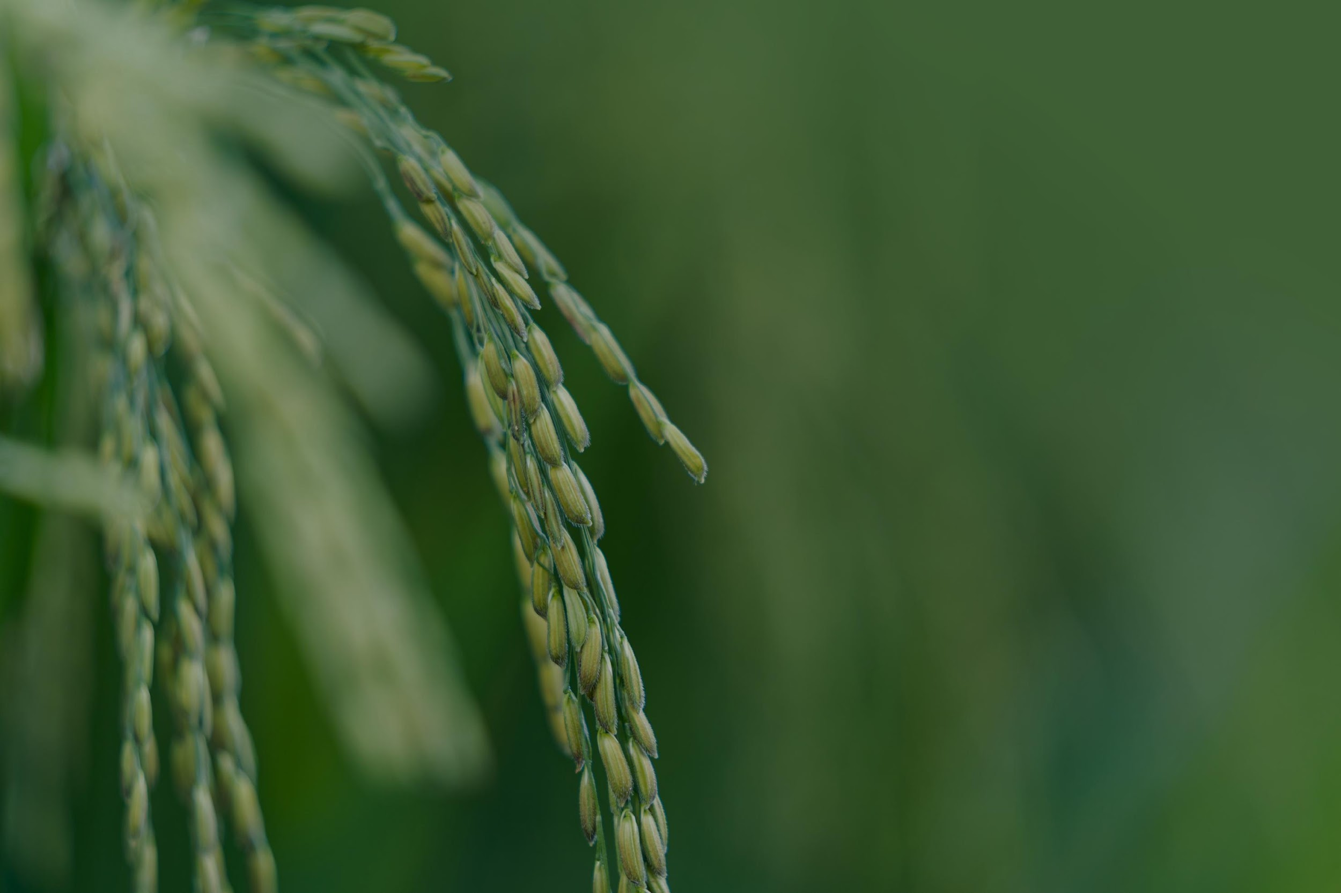

Role of Remote Sensing and GIS in Precision Agriculture
Start Here
-Omkar Dhumal.

Slide 2


Introduction to Precision Agriculture
Precision agriculture refers to the use of advanced technologies and data-driven approaches to optimize agricultural practices. It involves the precise management of resources such as water, fertilizers, and pesticides to maximize crop yields while minimizing environmental impact.

Slide 3
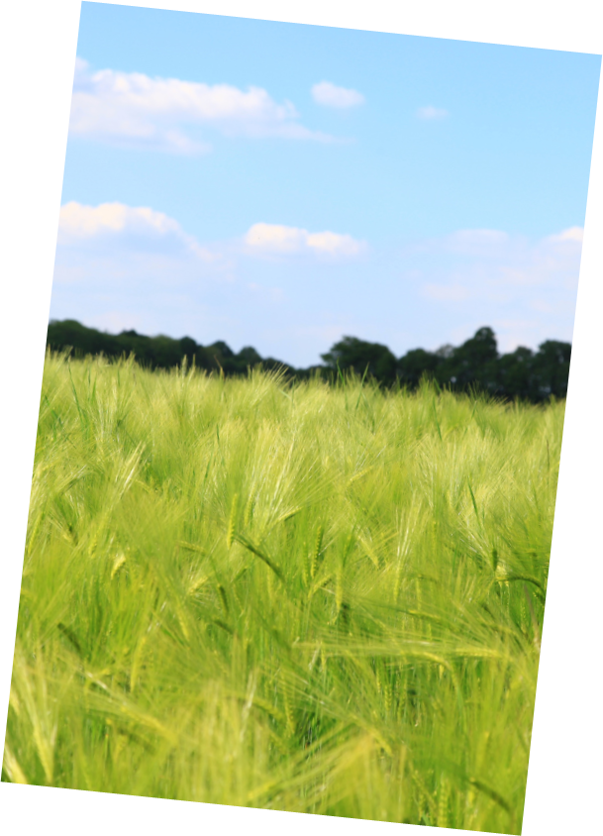
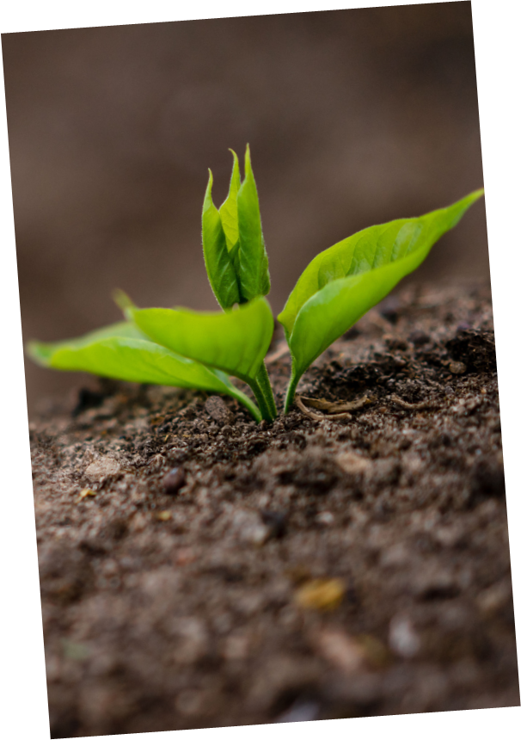
Soil Moisture Sensor:
This sensor measures the moisture content in the soil, providing crucial data for irrigation scheduling. It helps determine when and how much water is needed by the crops, optimizing water use efficiency.
Light Sensor:
The light sensor detects the intensity of sunlight, which is essential for crop growth. By monitoring light levels, the system can assess the need for irrigation based on environmental conditions and crop requirements.
Irrigation Pump and System:
The irrigation pump and system are responsible for delivering water to the crops. In the physical model, the pump activation is controlled based on specific conditions related to soil moisture and sunlight, ensuring efficient water management.

Slide 4


Working Principle
Explanation of the four conditions for pump activation:
Sunlight + Dry field = No pump activation
Sunlight + Moist soil = No pump activation
Night + Moist soil = No pump activation
Night + Dry field = Pump activation

Slide 5
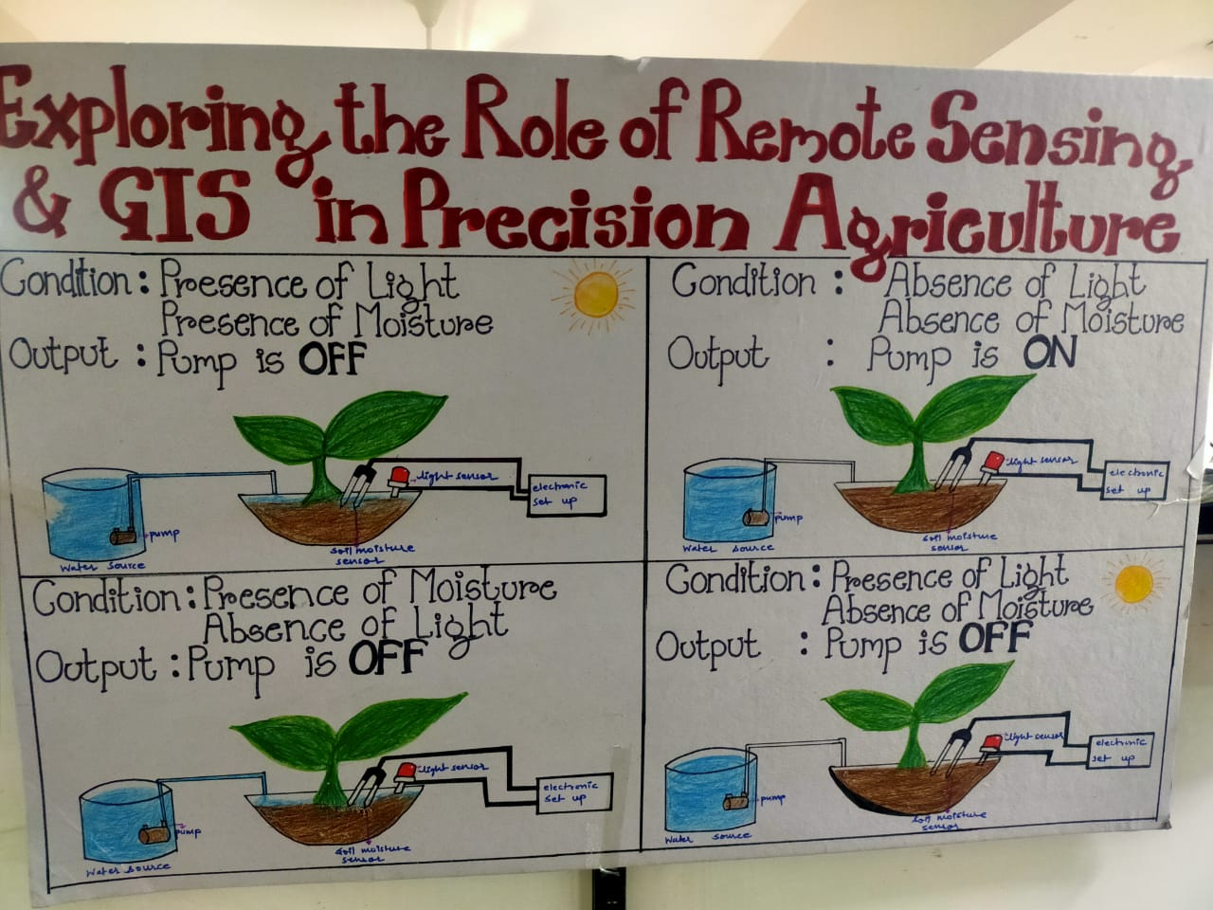

Slide 6
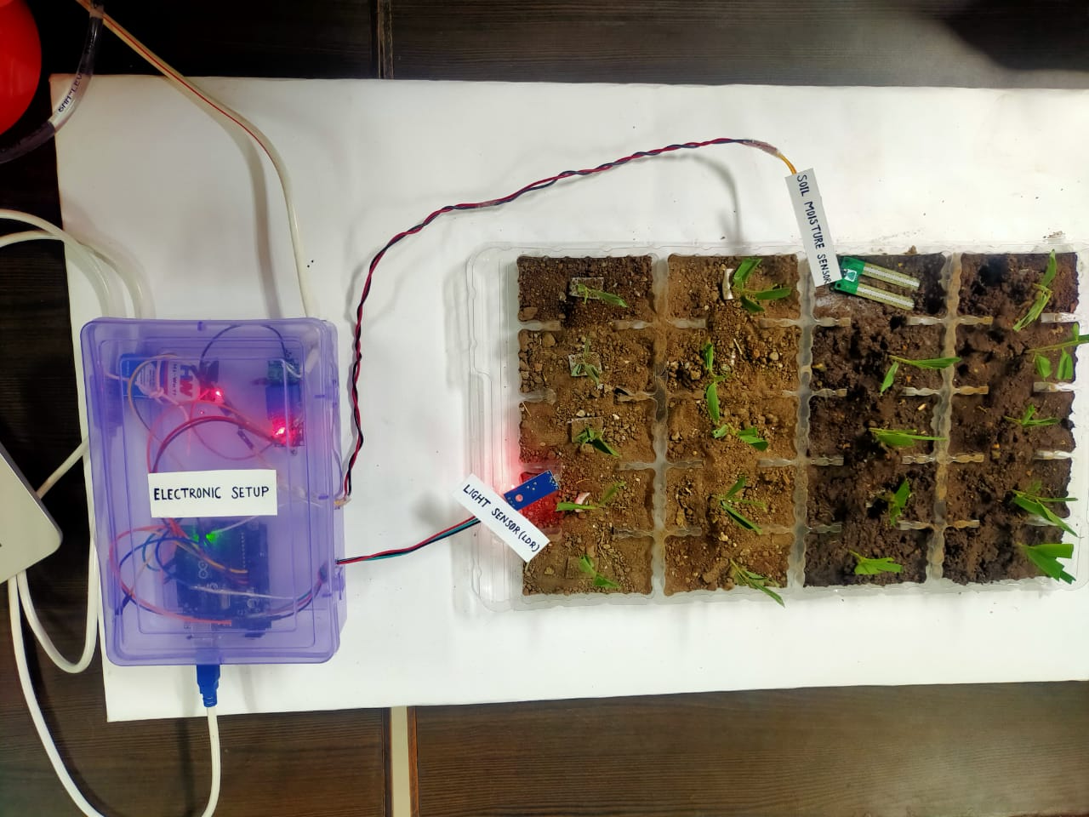

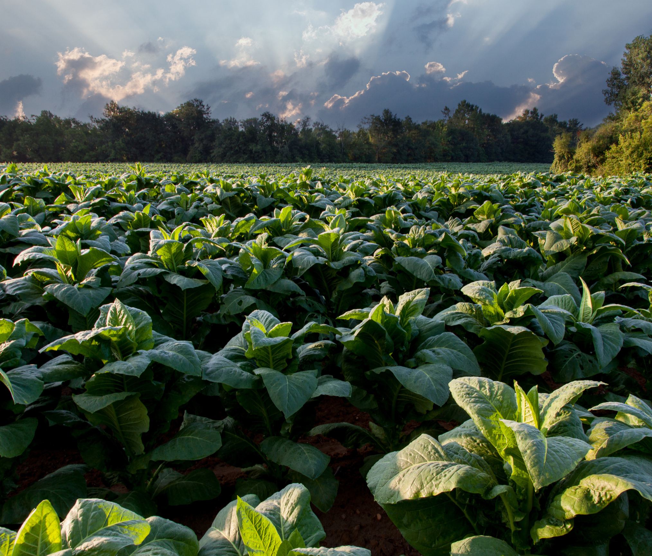

Slide 7

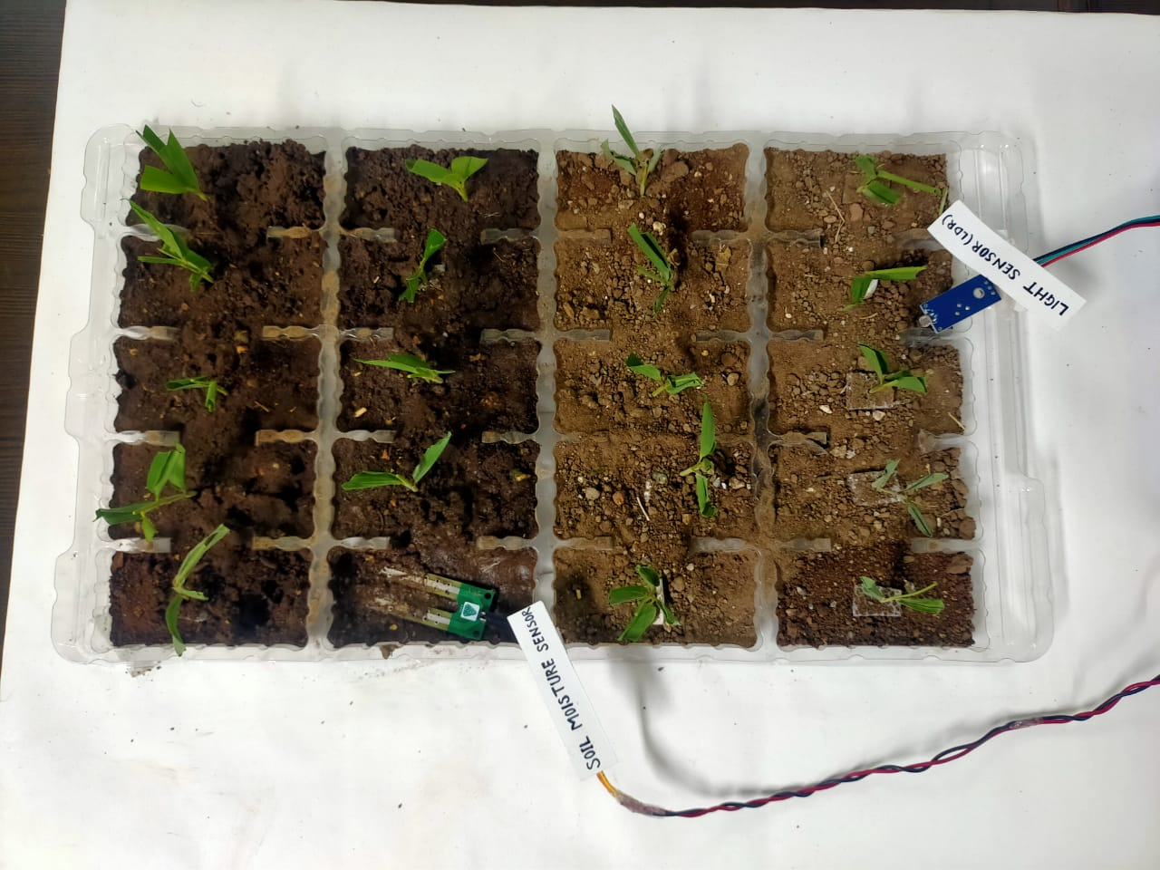

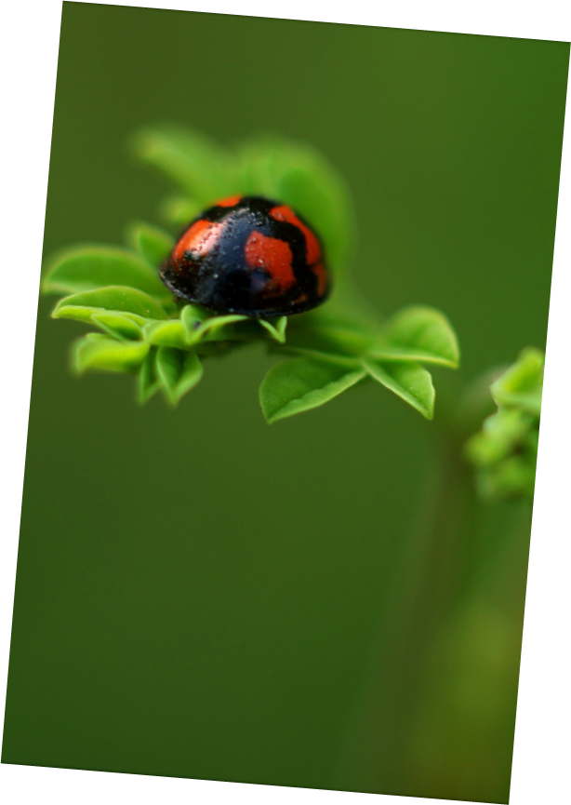


Slide 8
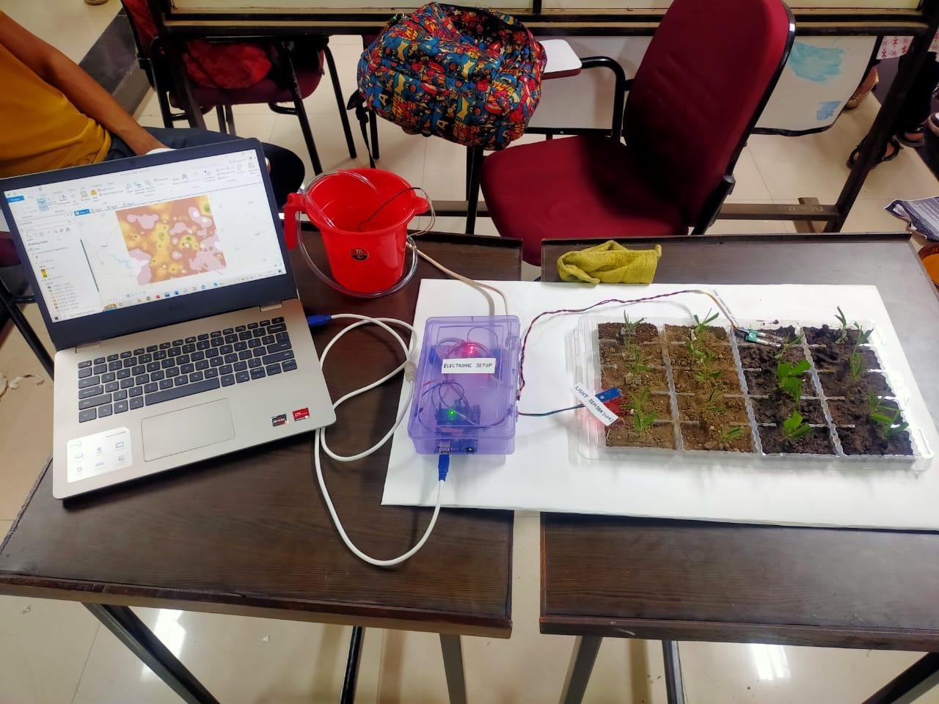

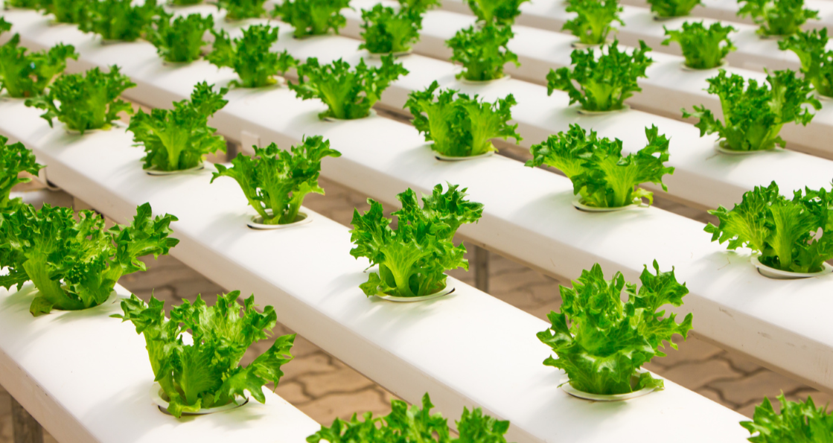
Market
Research
EXAMPLE
Elaborate on what you want to discuss.
EXAMPLE
Elaborate on what you want to discuss.
EXAMPLE
Elaborate on what you want to discuss.
EXAMPLE
Elaborate on what you want to discuss.

Slide 9
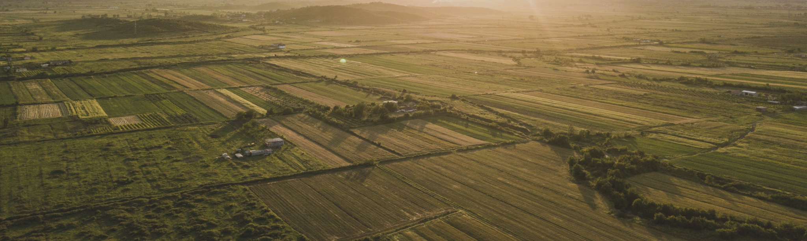
THANK YOU

